Slide 1

Important Factors in Separatist Movements through The Lens of The World Happiness Survey
By Kyler Deshpande (MPA/MAIR’25)
PAI 789 Advance Policy Analysis
Professor Wilcoxen

Slide 2
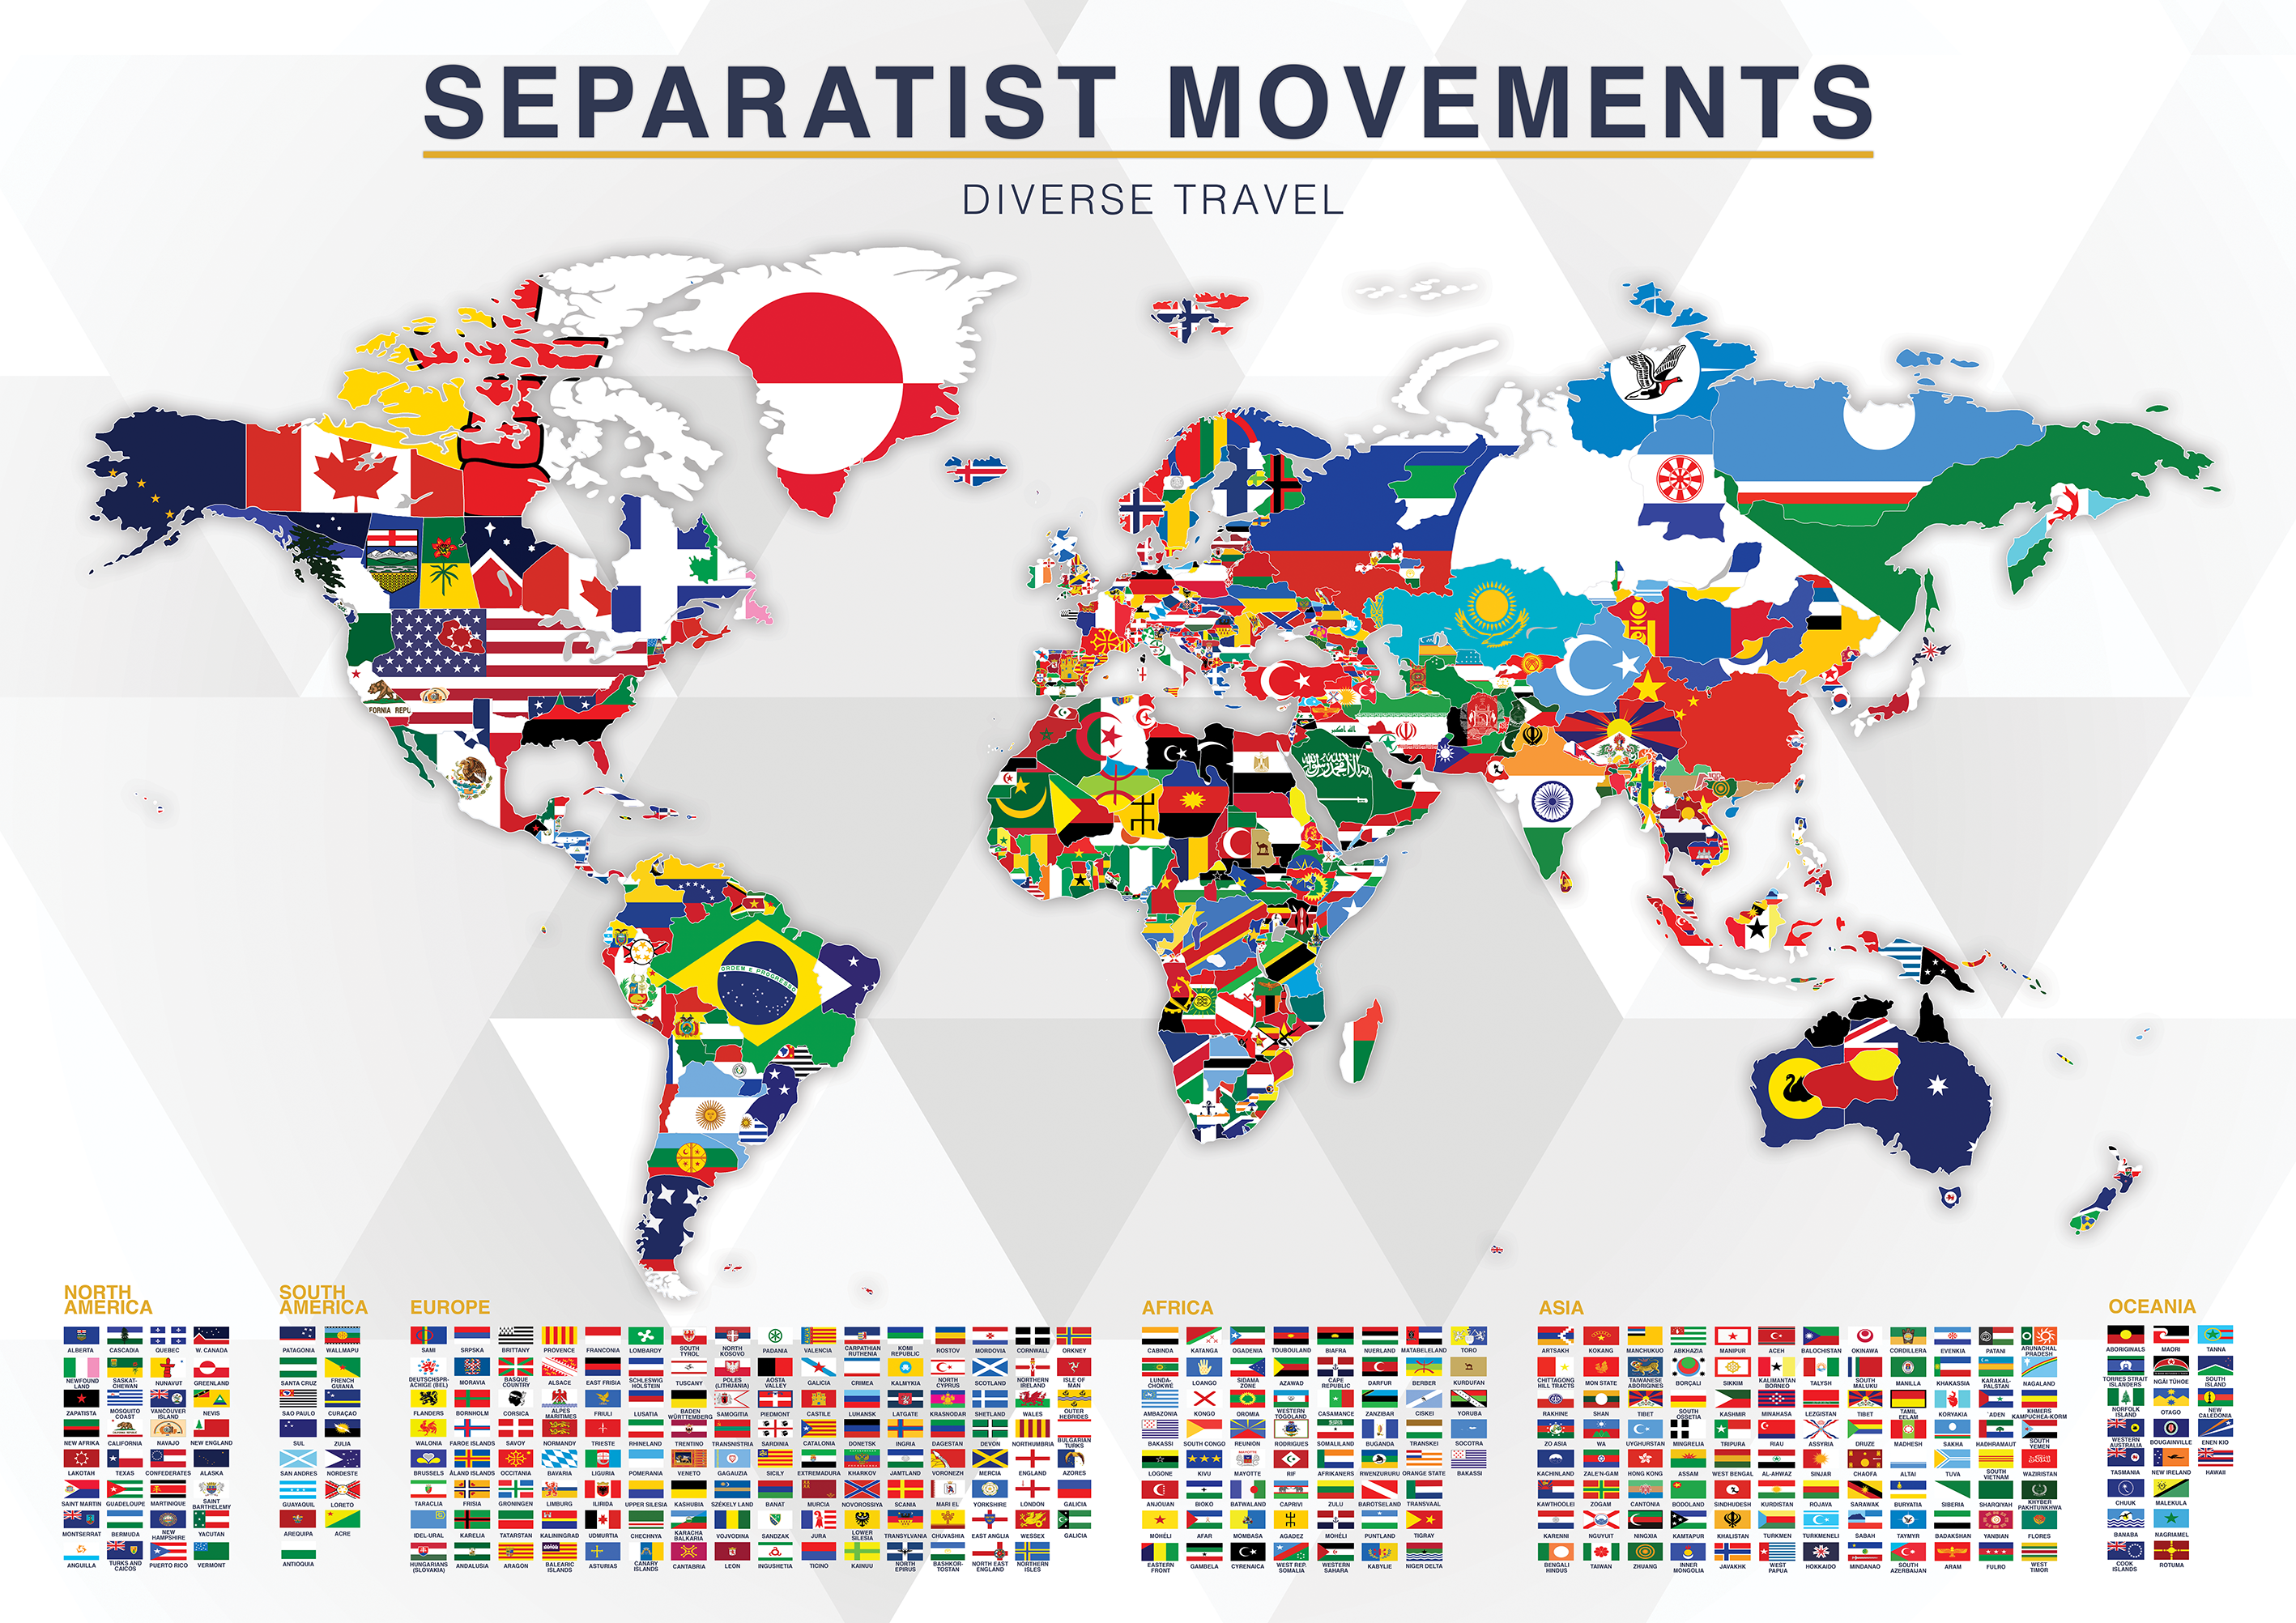
What is a separatist movement?
A movement within a state by a group of individuals who are wishing to make their own state
Groups are often based around a similar cultural identity that differs from most of the rest of the state

Slide 3


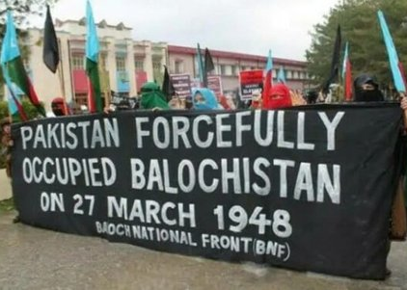
Well Known Examples: Catalonia, Quebec, and BAlochistan
Spain
Old principality
Canada
French Canada
Pakistan
Nomadic, pastoral, and now seafaring people

Slide 4
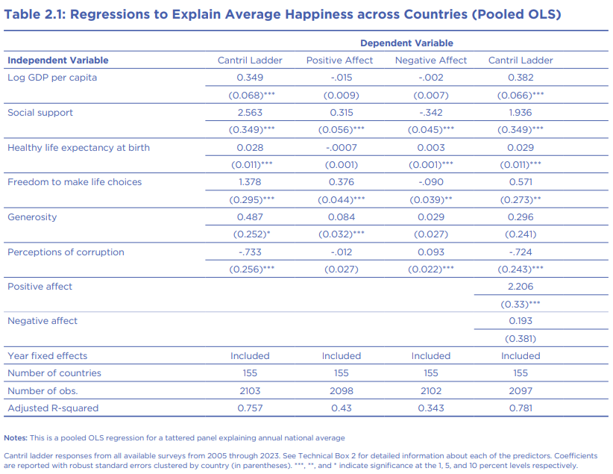
Data and Important Factors
The World Happiness Report
GDP
Social Support
Health Lifestyle
Freedom to make life choices
Generosity
Corruption
Dystopia residual

Slide 5
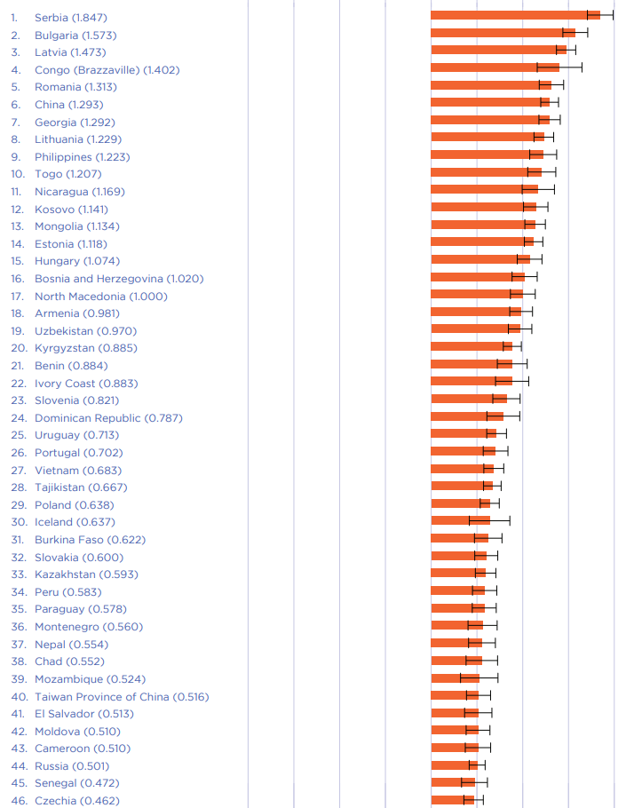
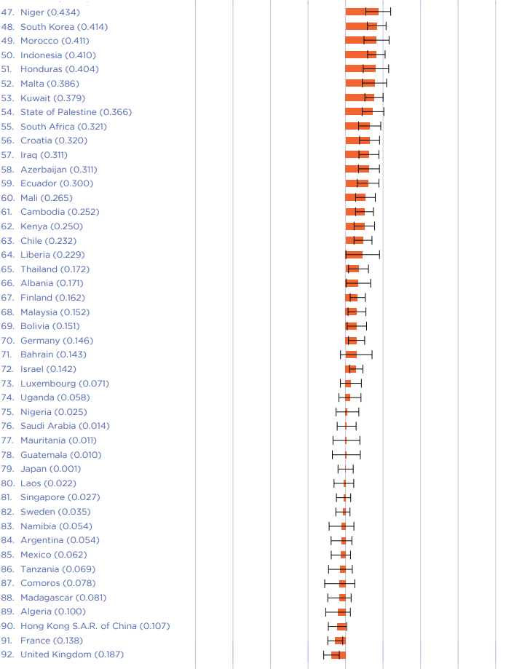
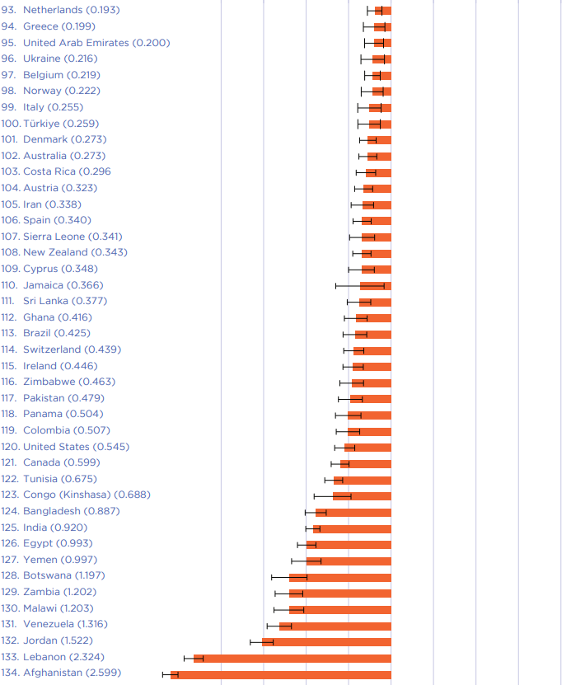
Change over time 2006-2010 to 2021-2023

Slide 6
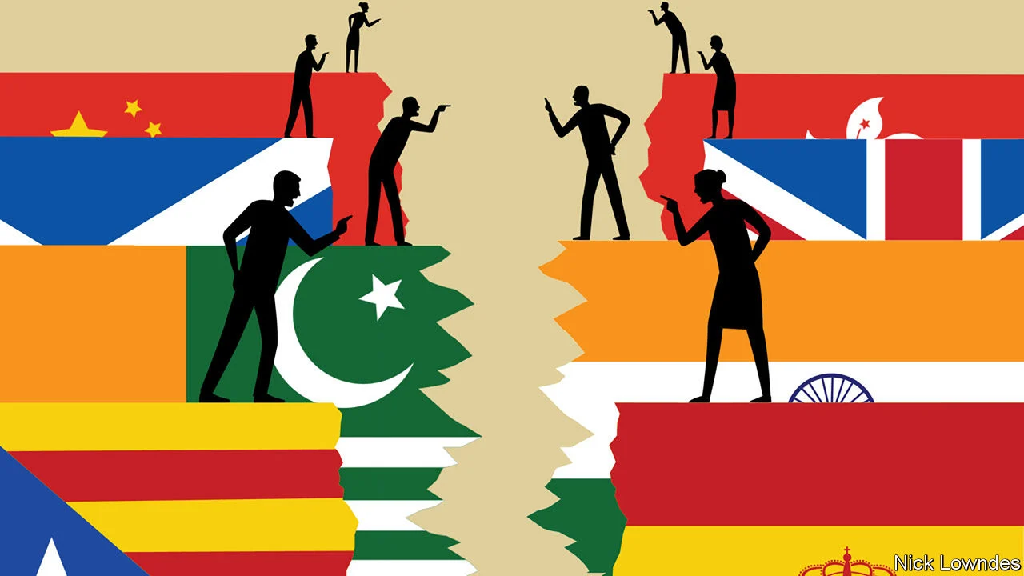
Findings and further research
When using the dystopian residual and taking out the states that have engaged in large scale fighting, countries with separatist movements are all moving down the ranking
Importance of corruption, social services, and freedom to make life choices
Double check for correlation and causation as well as post hoc ergo propter hoc
Problem of incomplete and bias data and narrative claims

